Slide 1
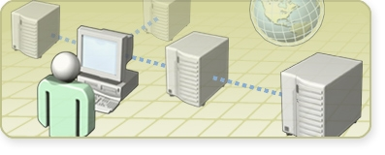
Session 1:
Benefits of Deploying the 2007 Office System

Slide 2

Session 1: Benefits of Deploying the 2007 Office System
2007 Office System Processes and Business Benefits
Increasing Personal Productivity by Using the 2007 Office System
Enterprise and Content Management Using the 2007 Office System
Collaboration Using the 2007 Office System
Knowledge Discovery and Insight Using the 2007
Office System
Information Worker Solutions and Fundamentals

Slide 3
2007 Office System Processes and Business Benefits
Trends for a New Working Environment
Business Benefits of the 2007 Office System

Slide 4
Trends for a New Working Environment
Trends | Needs | Microsoft 2007 Office System
One world of business | Connect with customers, partners, and coworkers | Collaboration
Always on, always connected | Find people and information | Knowledge Discovery and Insight
Regulatory compliance | Improved compliance and business processes | Enterprise Content Management
Internet generation | Greater individual impact to get better results faster | Personal Productivity

Slide 5









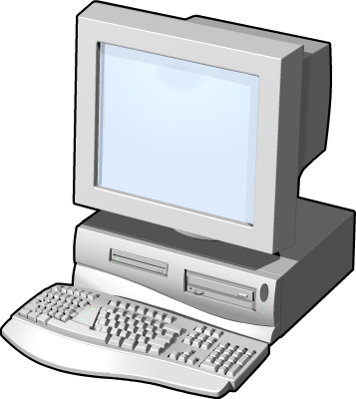



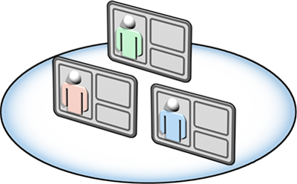
Business Benefits of the 2007 Office System
Enterprise Content Management
Collaboration
Personal Productivity
Knowledge Discovery
and Insight
Information
Worker Solutions
Fundamentals

Slide 6
Increasing Personal Productivity by Using the 2007 Office System
Personal Productivity Trends
How the 2007 Office System Addresses
Personal Productivity
Making Work Easier
Creating High-Impact Documents
Working Mobile Using the 2007 Office System
Information and Time Management

Slide 7

Personal Productivity Trends
Moving business processes to digital form has resulted in the following:
Training and support issues
Tools being used for incorrect functions
Latest versions of relevant information hard to manage
Redundant data causing an increase in storage costs
Many users not taking full advantage of IT infrastructure or software investments

Slide 8
How the 2007 Office System Addresses Personal Productivity
The 2007 Office system addresses personal
productivity by:
Making work easier
Providing the ability to create high-impact documents
Increasing worker mobility
Simplifying information, time, and work management
Personal Productivity

Slide 9
Making Work Easier
The 2007 Office System makes work easier by providing the following features:
Results-oriented user interface
Office Online community and resources
Online learning and help continuously improved by user feedback

Slide 10
Creating High-Impact Documents
Features that empower users to create high impact documents include:
Faster document authoring by using custom and prebuilt layouts and slide libraries
Fast, professional charting and diagramming

Slide 11
Working Mobile Using the 2007 Office System
Mobility features provided with the 2007 Office
System include:
SharePoint site information available offline
Easier extranet access to team collaboration sites

Slide 12
Information and Time Management
Information and time management features provided with the 2007 Office System include:
An improved task management system
Rapid search across e-mail and documents in Outlook
Calendar sharing and integration

Slide 13

Demonstration 1: Increasing Productivity by Using the 2007 Office System
In this demonstration, you will see:
The new user interface
Changes to the tooltips and
keyboard shortcuts
Task management improvements

Slide 14
Enterprise Content Management Using the 2007 Office System
About Enterprise Content Management
ECM in the 2007 Office System
Creating and Managing Content
Streamlining Document Process and Approval
Document Policy and Access Control

Slide 15
About Enterprise Content Management
Trends related to ECM include the following:
Exponential growth in electronic content
Corporate compliance, regulation, and governance
Protection of information and intellectual property
Existing solutions that are expensive and difficult
to use

Slide 16
ECM in the 2007 Office System
ECM capabilities enhanced with the 2007 Office
system include:
Creating and managing content easily
Streamlining document process and approval
Setting document policy and control access
Enterprise Content Management

Slide 17
Creating and Managing Content
The 2007 Office System helps to create and manage content by incorporating the following features:
Document and Web content integration
Content types with rich metadata
Comprehensive versioning
Office client integration

Slide 18
Streamlining Document Process and Approval
The 2007 Office system helps to streamline document process and approval tasks by incorporating the following features:
Document approval and extensible workflow
Multilanguage content publishing
Digital signatures

Slide 19
Document Policy and Access Control
Document policy and access control has been integrated into the 2007 Office system by means of:
Auditing user actions and document history
Centrally controlled rights, expiration, and retention
Information Rights Management applied to content types automatically

Slide 20
Demonstration 2: ECM Using the 2007 Office System
In this demonstration, you will see:
How to store and access documents by using an enterprise document repository Web site

Slide 21
Collaboration Using the 2007 Office System
About Collaboration
2007 Office System Collaboration Features
Integrating Communication
Extending Collaborative Workspaces
Finding Relevant People and Information
Enhancing People-Driven Processes

Slide 22
About Collaboration
Common trends related to collaboration issues include the following:
Heterogeneous communications
Geographically dispersed teams
Multiple information repositories

Slide 23
2007 Office System Collaboration Features
The 2007 Office system collaboration features provide the ability to:
Integrate communication
Extend collaborative workspaces
Find relevant people and information
Enhance people-driven processes
Collaboration

Slide 24
Integrating Communication
Some of the integrated communication capabilities of the 2007 Office system include:
Integrated experience for telephony, Web conferencing, and instant messaging
Single inbox for e-mail and voice mail

Slide 25
Extending Collaborative Workspaces
The 2007 Office system extends collaboration capabilities by incorporating the following:
Easy provisioning of team site extranets
Ad hoc, mobile, cross-organizational workspaces
Shared note taking for group collaboration

Slide 26
Finding Relevant People and Information
The 2007 Office system enhances search capabilities by incorporating the following:
Search extends to people and workspaces
Meeting recording, content organization, and
post-meeting archiving and search

Slide 27
Enhancing People-Driven Processes
The 2007 Office system enhances people-driven processes by incorporating the following:
Configurable workflows to coordinate
workgroup processes
Streamlined gathering of semi-structured data from collaboration partners
Simple project workspaces with the ability to upgrade and connect with Project Server

Slide 28
Demonstration 3: Collaboration Using the 2007 Office System
In this demonstration, you will see:
How to set up a collaborative
workflow process

Slide 29
Knowledge Discovery and Insight Using the 2007 Office System
About Knowledge Discovery and Insight
2007 Office Knowledge Discovery and Insight Features
Central Management of Business Information
Deeper Insight from Data
Finding Experts and Critical Information

Slide 30
About Knowledge Discovery and Insight
Common challenges and trends related to Knowledge Discovery and Insight include the following:
Difficult to find and access corporate information
and experts
Key performance indicators used to help align
business executions
Disconnect between Business Intelligence tools and how people actually work
Desire to get more out of data warehouse investments

Slide 31
2007 Office Knowledge Discovery and Insight Features
Knowledge Discovery and Insight features provide the ability to:
Manage business information centrally
Develop deeper insight from data
Find experts and critical information
Knowledge Discovery
and Insight

Slide 32
Central Management of Business Information
The 2007 Office system manages business information by providing the following features:
Secure spreadsheet access with server-based calculation and browser-based access
Centralized organization of business reports, spreadsheets, and data sources
Web service access to spreadsheets

Slide 33
Deeper Insight from Data
The 2007 Office system helps to develop deeper
insight from data by integrating the following features:
Enhanced data exploration, analysis, and visualization tools in Excel and Visio
Dashboard key performance indicators and business intelligence Web parts
Project portfolio and program tracking and indicators

Slide 34
Finding Experts and Critical Information
The following features are integrated into the 2007 Office system:
Search across Web sites, file shares and
local computers
Unlock content in SAP and custom repositories
Instantly find people with valuable expertise
Search by using XML Web services

Slide 35
Demonstration 4: Knowledge Discovery and Insight Using the 2007 Office System
In this demonstration, you will see:
How to set centrally manage Excel worksheets and publish them to the Report Center

Slide 36
Information Worker Solutions and Fundamentals
Challenges and Trends for the Information Worker
Information Worker Solutions Using the 2007
Office System
Fundamental Security, Privacy, and
Reliability Challenges
Addressing Security and Reliability in the 2007
Office System

Slide 37
Challenges and Trends for the Information Worker
Challenges and trends that face the information worker include the following:
Consolidation of server investments
Reengineering of paper-based processes
Increased business unit demands on IT for applications
Demand for a standards-based platform

Slide 38
Information Worker Solutions Using the 2007 Office System
Some of the main solutions incorporated within the 2007 Office system include:
Unified services-based architecture
Integration with business systems
Rapid development tools
Information
Worker Solutions

Slide 39
Fundamental Security, Privacy, and Reliability Challenges
Challenges related to fundamental security and management include:
Evolving security threats
Concerns about privacy
Inconsistent update experience
Multilanguage deployment needs

Slide 40
Addressing Security and Reliability in the 2007 Office System
Security, reliability, and manageability
fundamentals include:
Security by design, default, and deployment
Simplified update and deployment
Improved reliability and quality
Fundamentals

Slide 41
Session Summary
2007 Office System Processes and Business Benefits
Increasing Personal Productivity by Using 2007 Office
Enterprise and Content Management Using the 2007 Office System
Collaboration Using the 2007 Office System
Knowledge Discovery and Insight Using the 2007
Office System
Information Worker Solutions and Fundamentals

Slide 42
Questions and Answers

